Slide 1

Azure SQL Database Elasticity
Queries, Jobs, & Transactions
Steve Hughes
SQL Saturday Memphis 2022 (#1033)
October 2022

Slide 2


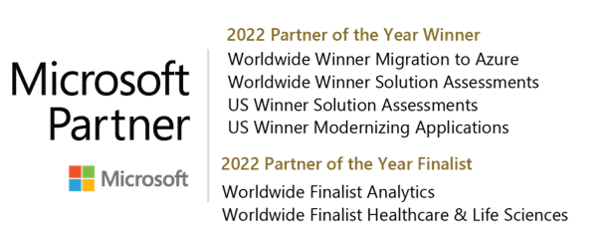
Steve Hughes
Senior Director, Data & Analytics, 3Cloud
Founder, Data on Wheels
20+ Years with SQL Server, Microsoft BI, and Azure
Working with ALS, adapting and growing
https://www.linkedin.com/in/dataonwheels/
steve@dataonwheels.com
Blog: www.dataonwheels.com – Look for deck and follow up here

Slide 3
Elastic queries

Slide 4
Elastic Queries
Elastic Queries are similar to Polybase functionality found in SQL Server 2019 and Azure Synapse
They allow developers to distribute query workloads across Azure SQL Databases by distributing the data
If you are familiar with Polybase or Synapse Serverless, you will see the same external table syntax used here without the additional connection complexity
Included in the cost of Azure SQL Database in standard and premium tiers
This functionality is still in preview
Reference: https://docs.microsoft.com/en-us/azure/azure-sql/database/elastic-query-overview

Slide 5
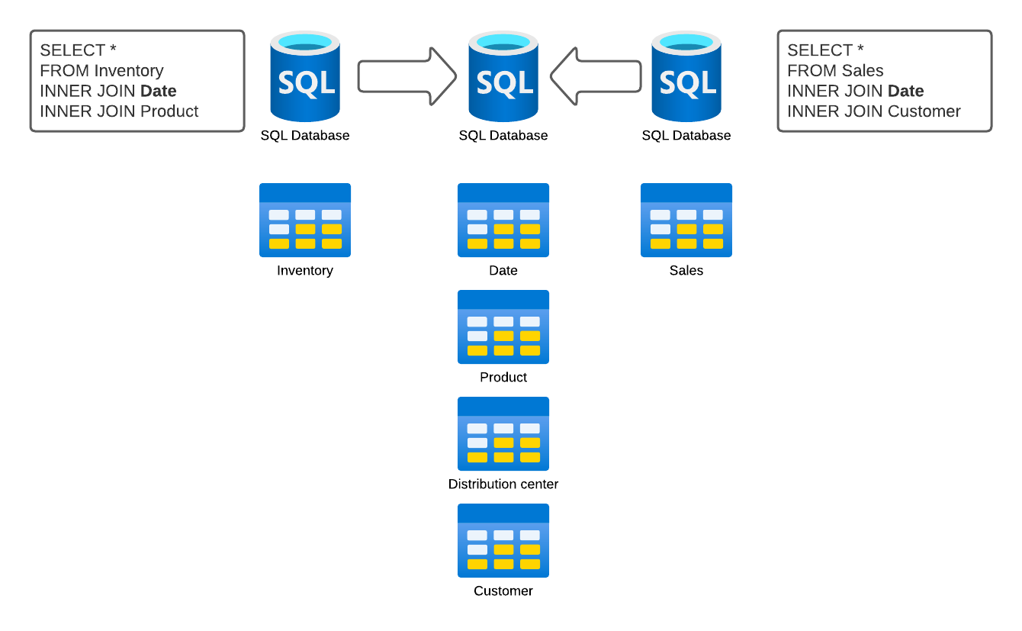
Elastic Query - Vertical
Vertical partitioning Complete tables in separate databases.
Can be shared table such as date tables or even dimensions.
Allows us to create scale the data solution out.

Slide 6
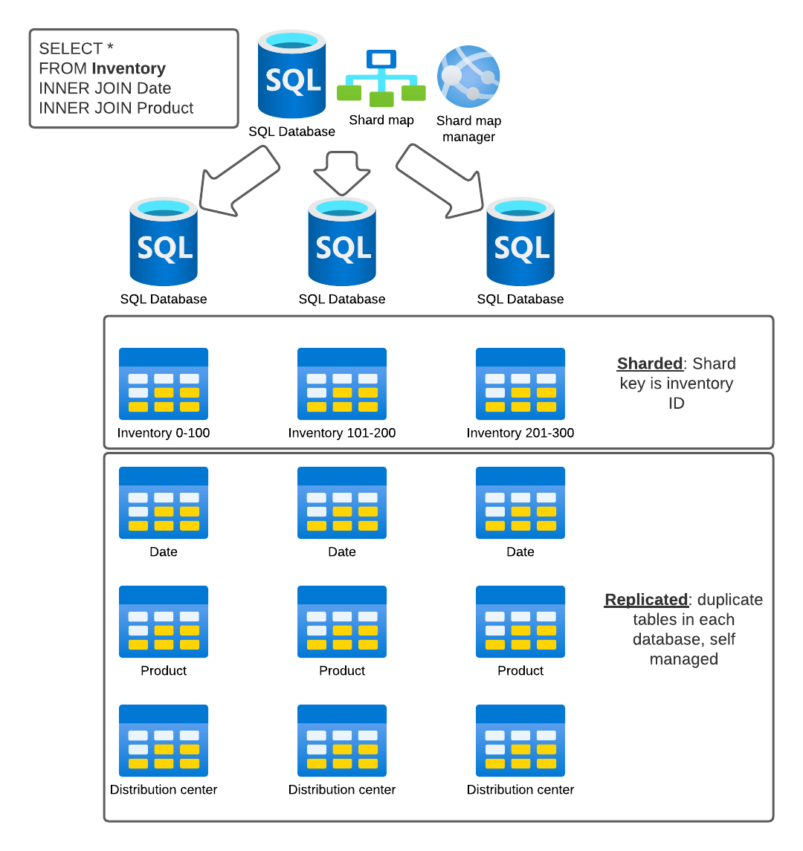
Elastic Query - Horizontal
Horizontal Partitioning or Sharding
Pieces of a larger table are distributed across multiple databases and pulled together in an elastic query.
Requires a shard map implemented with .NET or Java applications.

Slide 7
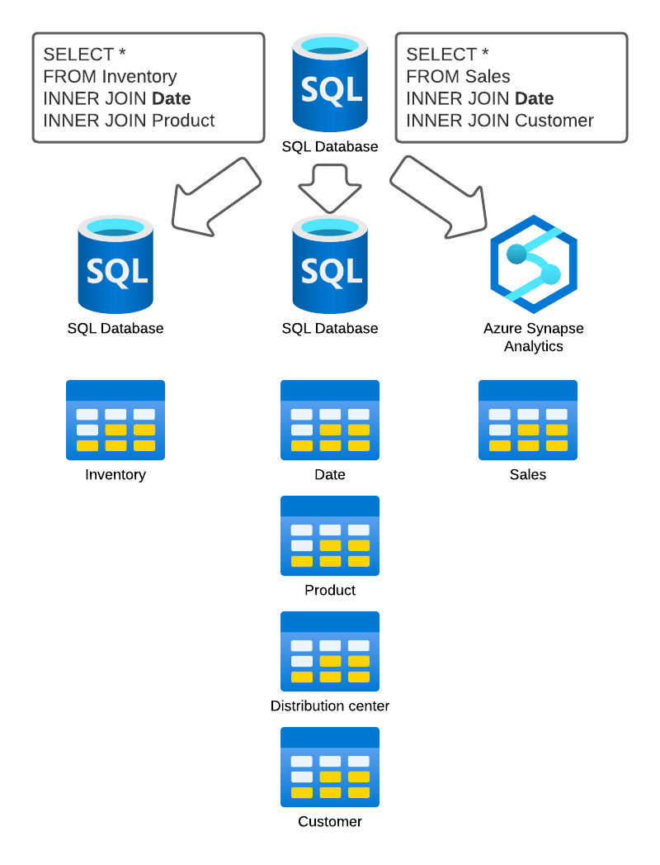
Elastic Query - Virtualization
Data virtualization Bringing data from different solutions together into a single database.
SQL database user querying has no physical table
Virtualizing data in a single database access point.

Slide 8
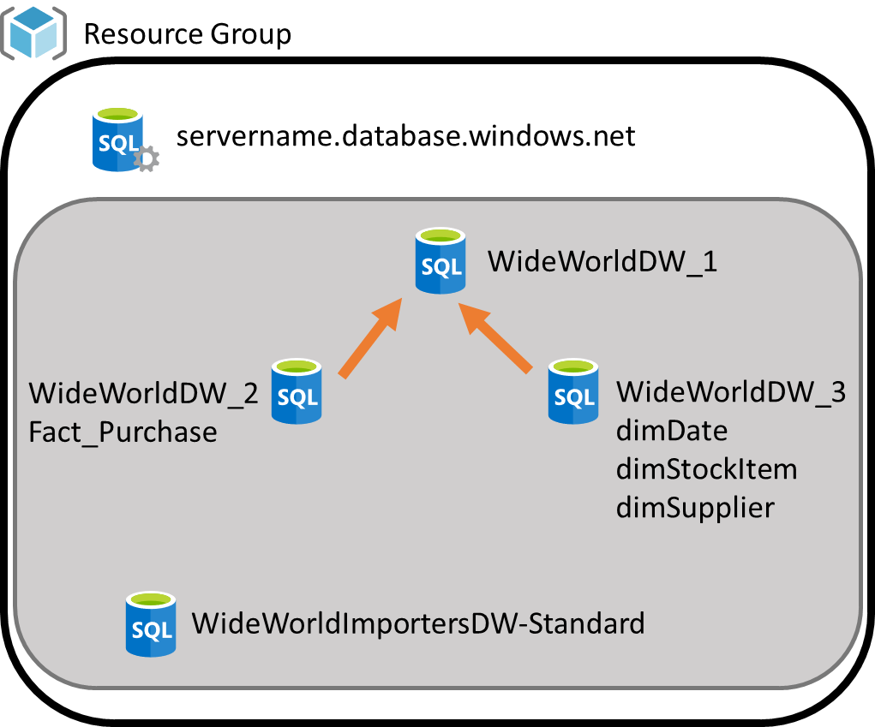
Data virtualization - Demo Configuration
Three S1 Azure SQL Databases on the same Azure SQL Server
S2 Azure SQL Database created when restoring WideWorldImportersDW
ADF used to move Fact.Purchase to WideWorldDW_2 and the three related dimensions to WideWorldDW_3
WideWorldDW_1 is set up to query both WideWorldDW_2 and WideWorldDW_3 as external data sources.

Slide 9
Elastic query Data virtualization demo

Slide 10
Elastic Query Final Thoughts
Still in preview
Only usable with Azure SQL Database and Azure Synapse
Costs
Included in the price of Azure SQL Database
Standard starts up slower than premium
Data center distribution will incur egress costs
Read-only currently supported, writes through external table connections are not supported
Not optimized for ETL operations, should be limited to reporting or cross database querying needs

Slide 11
Elastic jobs

Slide 12
Elastic Jobs
Provides a mechanism to support T-SQL scripts to be run across one or more databases in parallel, on demand or on a schedule
Requires a dedicated “job database”
Jobs are “free”, the job database is not
A job is a collection of job steps which are SQL statements to be executed against the specified target
Jobs can be created in the portal, with Powershell, with REST, or with SQL
Reference: https://docs.microsoft.com/en-us/azure/azure-sql/database/elastic-jobs-overview

Slide 13
Elastic Job Targets and Steps
Target Groups
Jobs and Job Steps
Databases
One or more can be added to a group
Server
Target all the databases in the server
Pools and Shard Maps can be targeted as well
A job contains one or more steps
A job step is a unit of work to be done which is defined with TSQL
Jobs can be executed on demand or on a schedule
Job history is stored with detail for 45 days

Slide 14

Elastic Job Demo
New database added – S0 minimum to be the job database - ElasticJobDb
Elastic Job agent created using the portal – passmndemo
T-SQL used to create and manage target groups, jobs, and job steps
Two Groups
Two Jobs

Slide 15
Elastic job demo

Slide 16
Elastic transactions

Slide 17
Elastic Transactions
Allows you to create cross database transactions in Azure SQL Database
Replaces MSDTC in PaaS, built into Azure SQL Database, no additional components required
Application driven - .NET library supported in the current version
Supports transactions that span databases and servers with PowerShell
Supports sharded database applications which need atomic control in the transactions
Supports transactions across fewer than 100 databases well, no limit, but performance can suffer

Slide 18
Elastic Transactions Limitations
Only supports Azure SQL Databases
Only supports .NET transactions, it DOES NOT support T-SQL distributed transactions (e.g. BEGIN DISTRIBUTED TRANSACTION)
Transactions across WCF are not supported
Reference: https://docs.microsoft.com/en-us/azure/azure-sql/database/elastic-transactions-overview

Slide 19
Resources for the Demos
Sample databases: https://github.com/Microsoft/sql-server-samples/releases/tag/wide-world-importers-v1.0
Code can be found on github at https://github.com/DataOnWheels/codeshare/tree/master/PASS%20MN%20Sept%202020%20-%20SQL%20Azure%20Elasticity
Azure Data Factory jobs not included here. Use the Copy Tasks to move the tables to the target databases.

